Slide 1
MOVIE RATING & REVIEW PLATFORM
Presented By:
1.SUREDDYVISHNUREDDY,BHASKAR ENGINEERING COLLEGE -COMPUTER SCIENCE AND ENGINEERING

Slide 2
OUTLINE
Problem Statement (Should not include solution)
System Development Approach (Technology Used)
Algorithm & Deployment (Step by Step Procedure)
Result
Conclusion
Future Scope(Optional)
References

Slide 3
Problem Statement
Movie enthusiasts often struggle to find a reliable platform where they can discover movies, share honest reviews, and rate films based on their personal experiences.
This platform shows movie info and allows users to rate and comment. It fosters engagement and helps users decide what to watch.
While there are multiple sources of movie information online, most lack a community-driven space that combines accurate movie details with user-generated ratings and discussions.

Slide 4
System Approach
Frontend Technologies:
HTML5
Provides structure for movie hub pages
Elements: search bar, movie cards, reviews section
CSS3
Styling, dark mode theme, responsive grid layout
Hover effects & transitions for interactivity
JavaScript (ES6+)
Dynamic behaviour (search movies, handle clicks, star ratings)
DOM manipulation for updating reviews in real-time

Slide 5
API Integration
OMDb API
Fetches movie details (title, year, poster, IMDb ID)
Used for real-time search results
IMDb Rapid-API (News API)
Fetches latest celebrity & movie news
Displays updates within platform
Data Storage
LocalStorage (client-side storage)
Stores user reviews & ratings
Data persists even after page reload
JSON format used for storing review objects

Slide 6
Algorithm & Deployment
Input (User Search/Interaction)
User enters a movie name in the search bar.
API Request
OMDb API fetches movie details.
IMDb Rapid-API fetches latest news.
Processing
Extracts movie title, poster, year, ID.
Handles star ratings & reviews.
Storage
Reviews & ratings stored in Local Storage.
Output (Display UI)
Movies displayed with poster, details, ratings & reviews.

Slide 7
Product Catalog Creation
Movies fetched dynamically via OMDb API.
Celebrity/movie news via RapidAPI.
Catalog includes:
Poster, Title, Year
Interactive Star Rating
User Reviews Section

Slide 8
User Interaction Features
⭐ Star Rating System
Interactive (hover, click, highlight stars)
Ratings stored in LocalStorage
📝 Review Submission
Prompt-based input from user
Instantly updates review section
🔍 Search Functionality
Movie search using OMDb API
Displays results dynamically in grid layout
📰 Latest News Integration
Shows trending celebrity/movie news via RapidAPI

Slide 9
Frontend Design:
HTML5
Provides structure for movie hub pages
Elements: search bar, movie cards, reviews section
CSS3
Styling, dark mode theme, responsive grid layout
Hover effects & transitions for interactivity
JavaScript (ES6+)
Dynamic behaviour (search movies, handle clicks, star ratings)
DOM manipulation for updating reviews in real-time

Slide 10
Testing
Functional Testing
Movie search works correctly.
Ratings & reviews saved in LocalStorage.
UI Testing
Responsive design on desktop
Smooth animations and hover effects.
API Testing
Successful connection with OMDb & RapidAPI.
Error handling for invalid searches.

Slide 11
Deployment
Hosting Options:
GitHub Pages (static hosting).
Replit
Steps:
Upload HTML, CSS, JS files.
Configure API keys (secure handling in backend – future scope).
Publish & share live link with users.

Slide 12
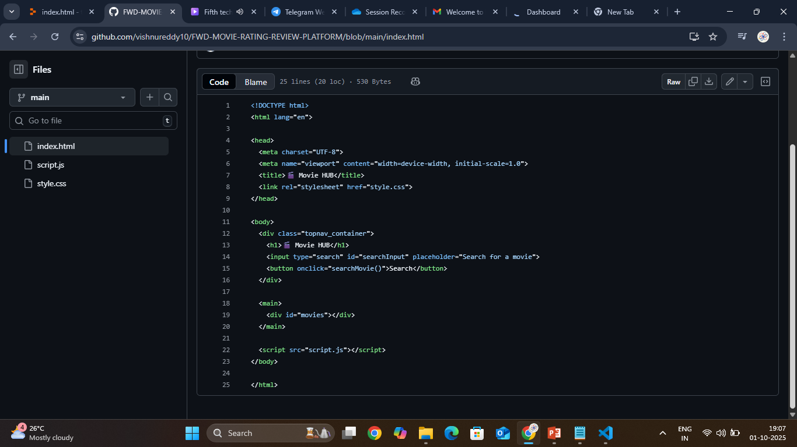
Result
Index.html code

Slide 13
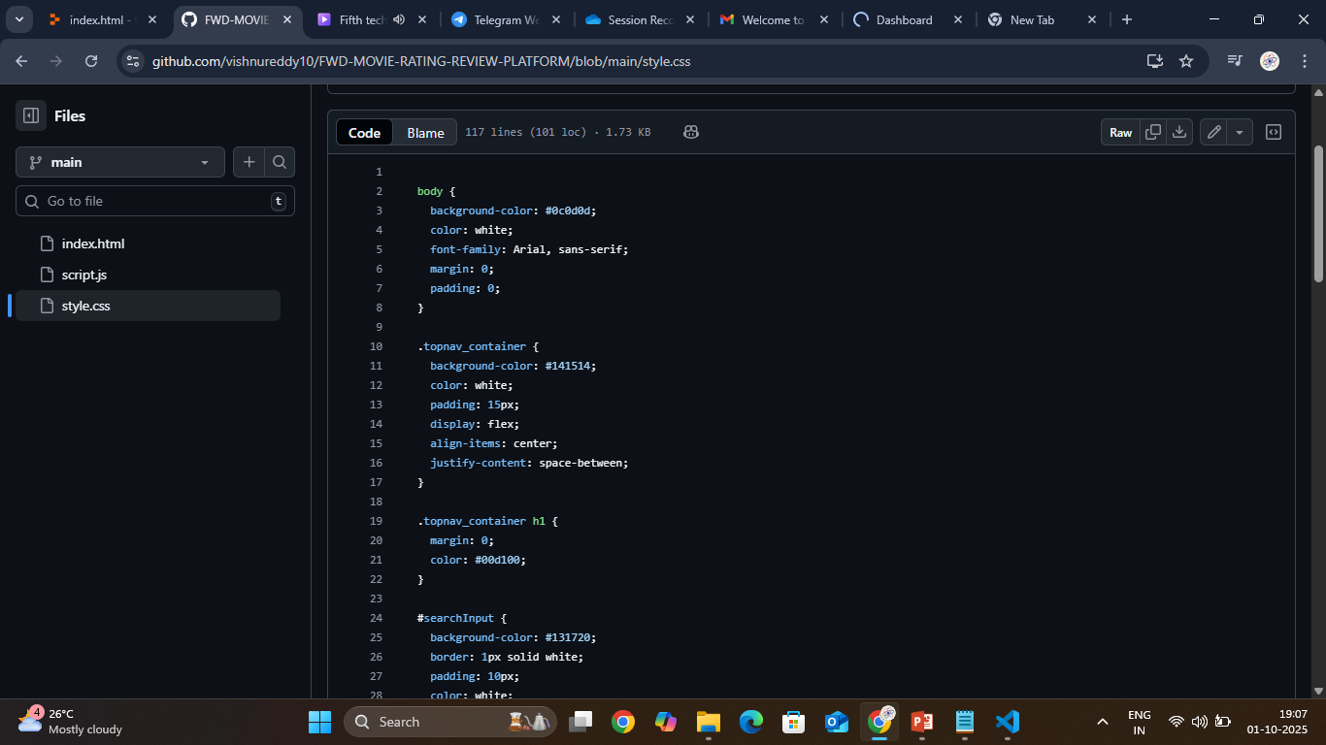
STYLE.CSS CODE

Slide 14
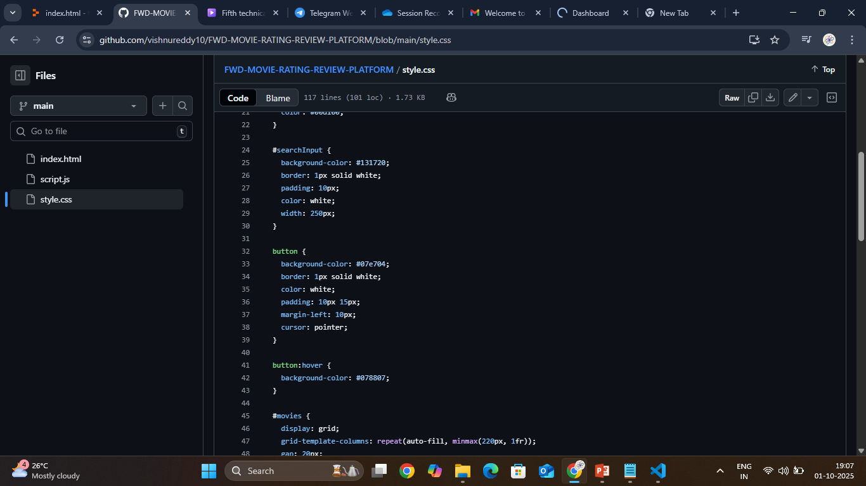

Slide 15
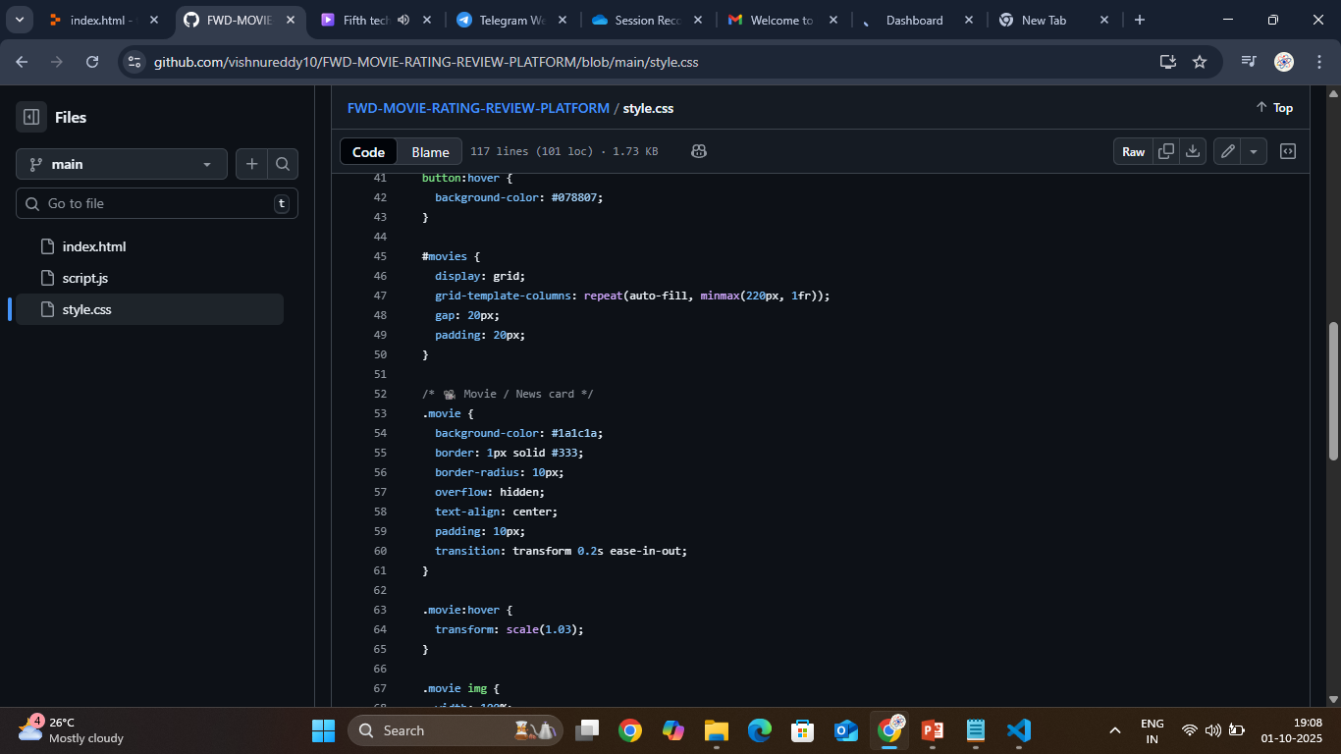

Slide 16
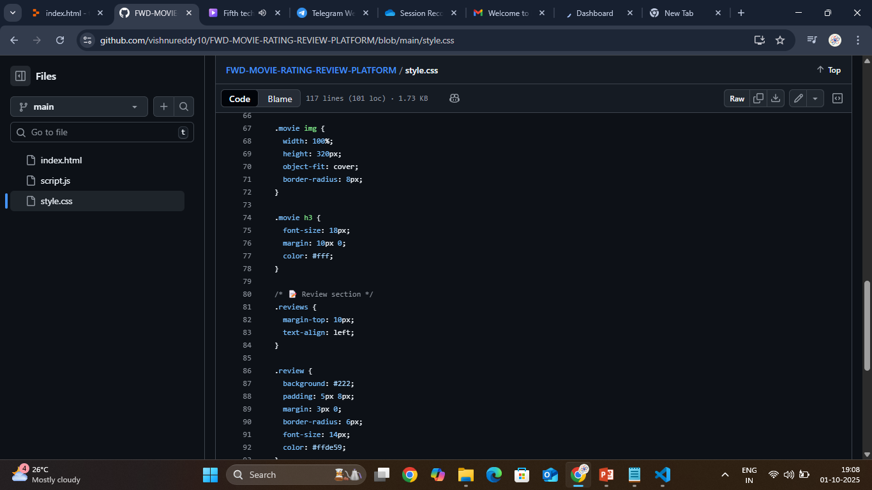

Slide 17
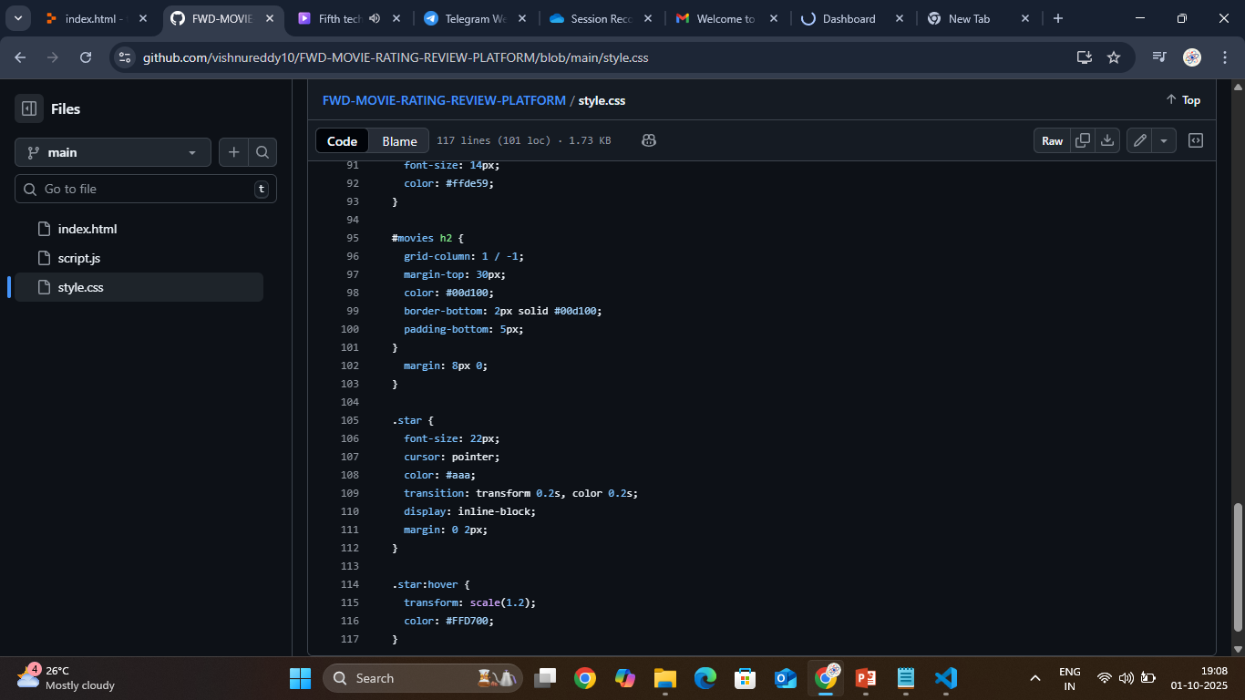

Slide 18
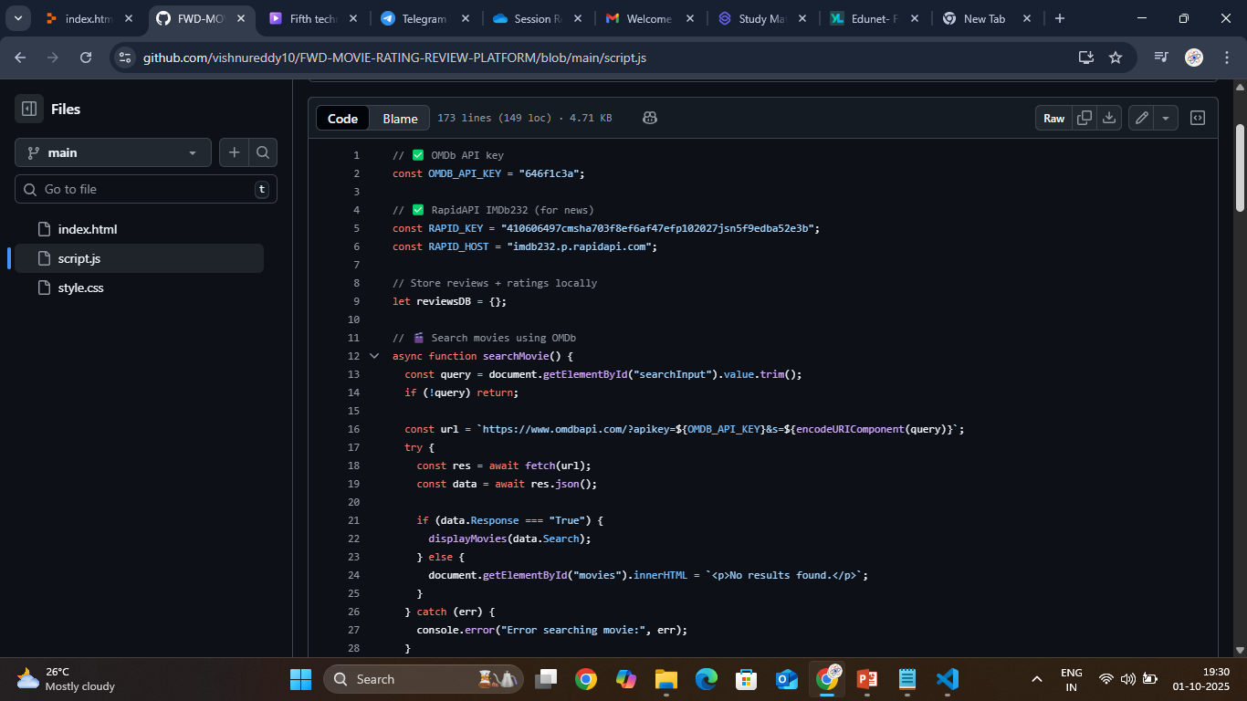
SCRIPT.JS CODE

Slide 19
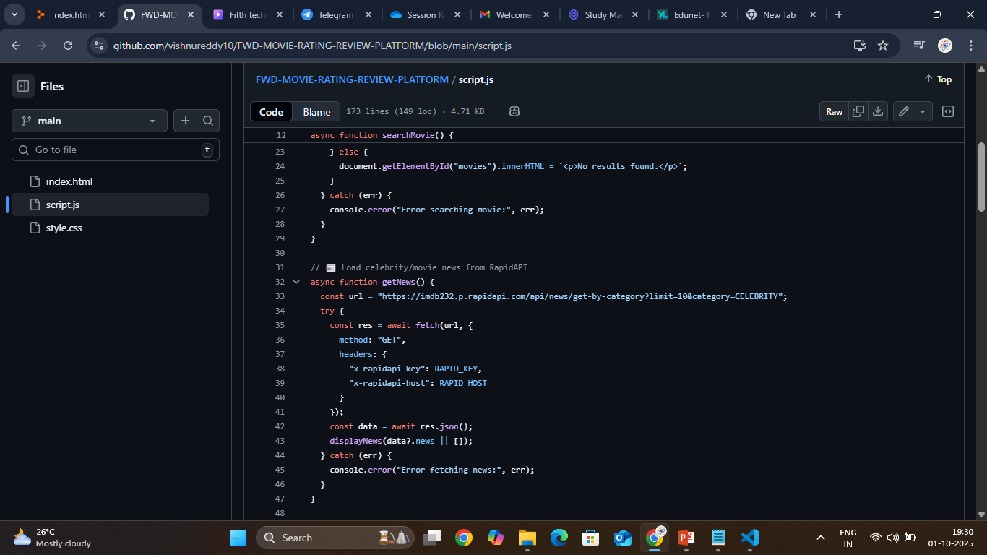

Slide 20
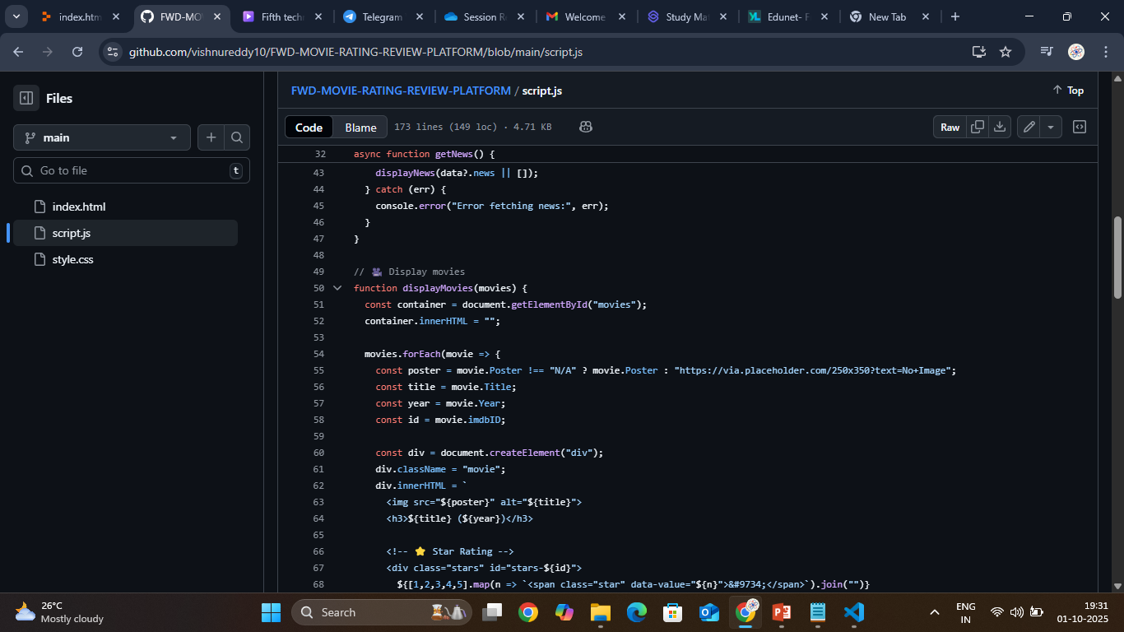

Slide 21
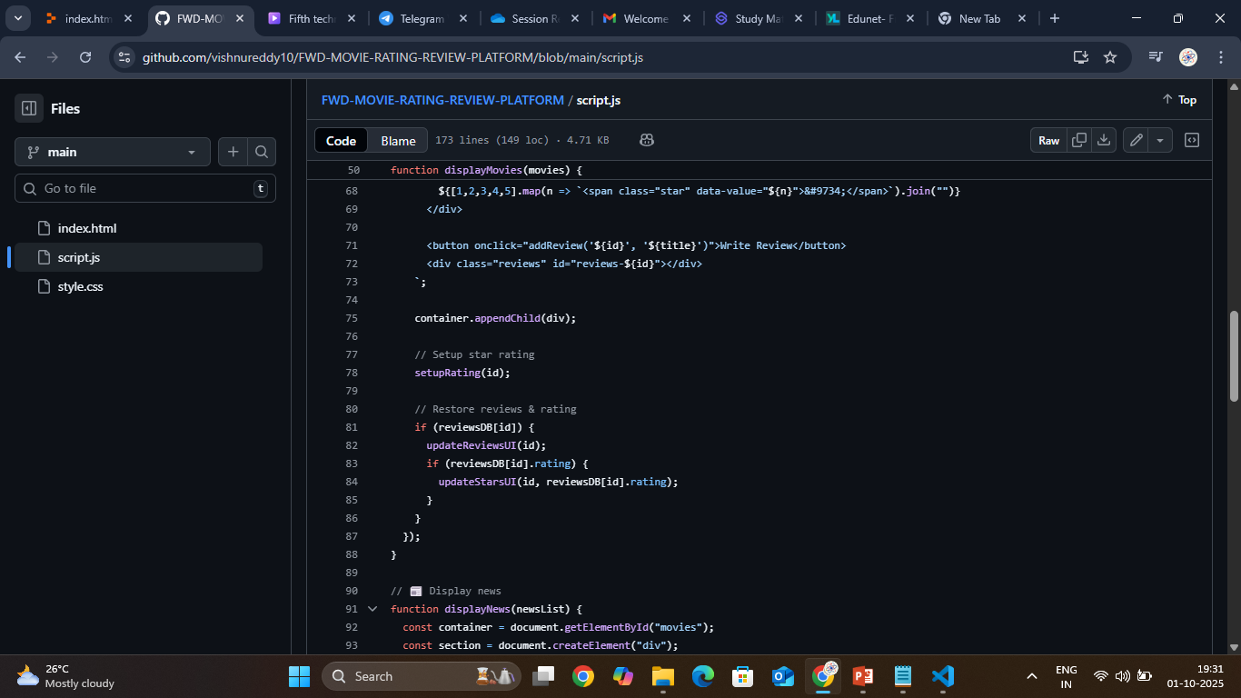

Slide 22
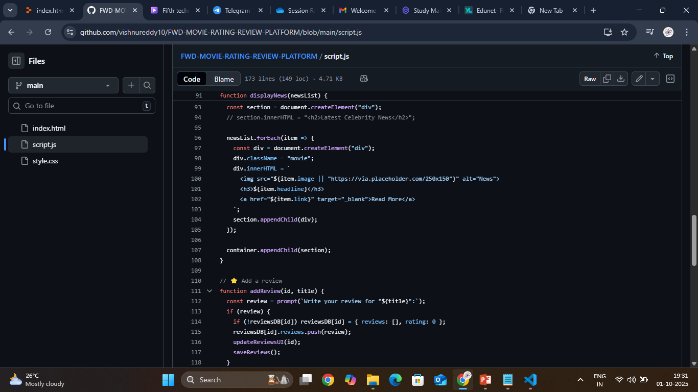

Slide 23
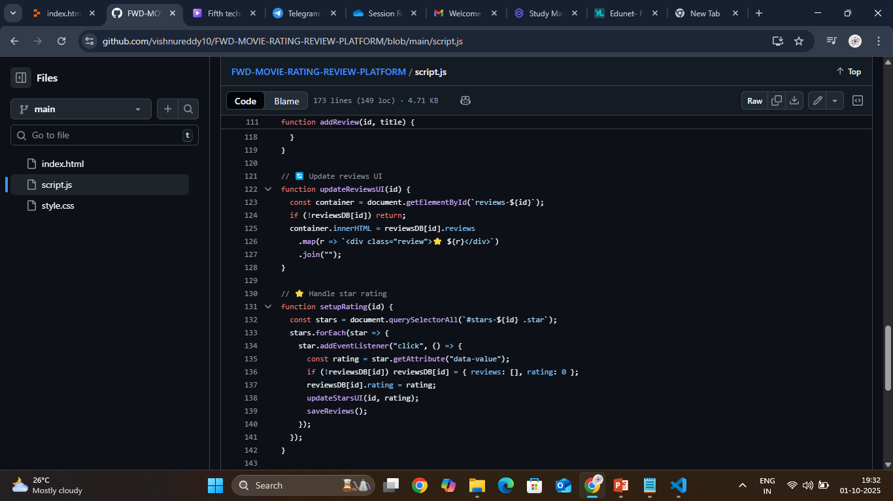

Slide 24
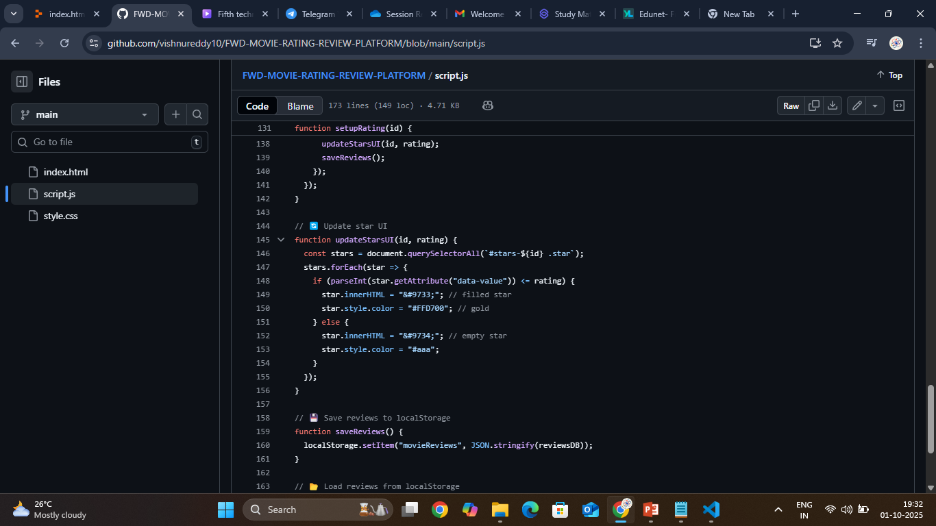

Slide 25
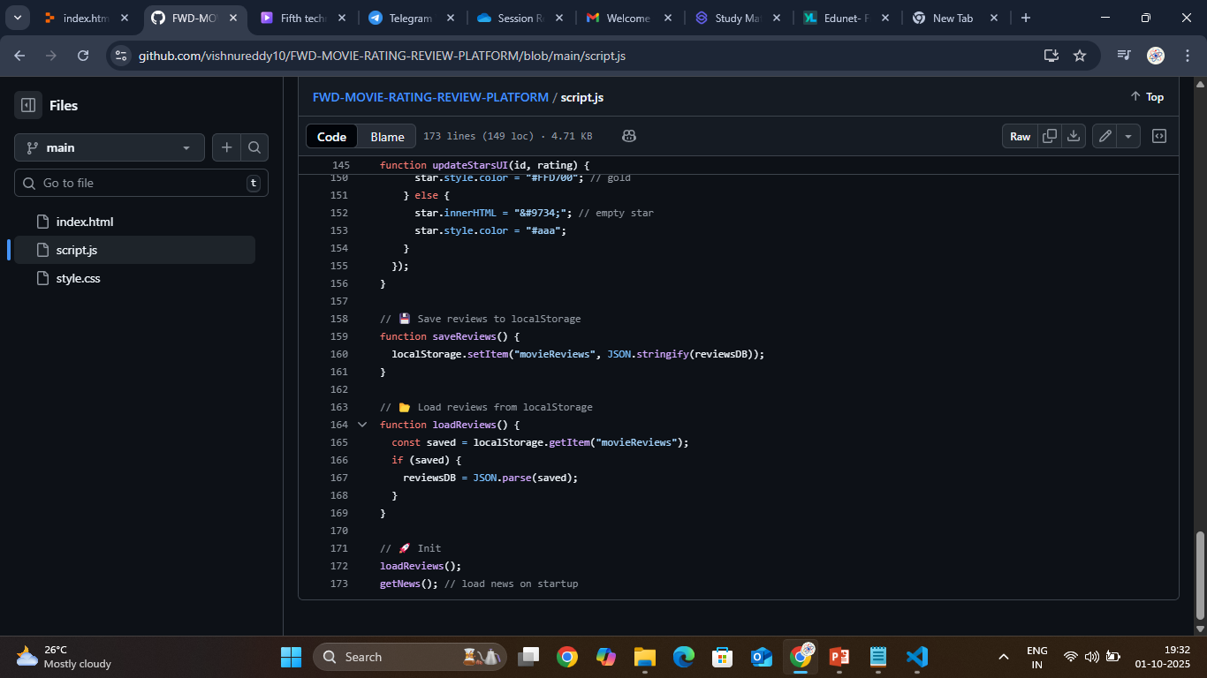

Slide 26
Attach your Git-hub link :https://github.com/vishnureddy10/FWD-MOVIE-RATING-REVIEW-PLATFORM.git
Deployment Link :https://vishnureddy10.github.io/FWD-MOVIE-RATING-REVIEW-PLATFORM/

Slide 27
Conclusion
The Movie Rating & Review Platform successfully provides a centralized, user-friendly space for movie enthusiasts to:
Discover movies with verified details,
Share authentic ratings and personal reviews,
By integrating modern frontend technologies (HTML, CSS, JavaScript, React), API support (OMDb, IMDb RapidAPI), and interactive features (star ratings, reviews, search, and filters), the platform enhances usability, and engagement.

Slide 28
Future scope
Adding social login & user profiles,
AI-based movie recommendations,
Advanced analytics for trending movies,
Cloud-based backend for global access.

Slide 29
References
List and site relevant sources, research papers, and articles that were instrumental in developing the proposed solution
OMDb API. (n.d.). OMDb API (Open Movie Database). Retrieved from http://www.omdbapi.com/
The Movie Database (TMDb). (n.d.). TMDb API documentation. Retrieved from https://developer.themoviedb.org
Item-based collaborative filtering recommendation algorithms. Proceedings of the 10th International World Wide Web Conference. Retrieved from https://dl.acm.org/doi/10.1145/371920.372071

Slide 30
THANK YOU

